Slide 1
Module 2: Manage leads and opportunities in Dynamics 365 Sales

Slide 2
Module agenda
Manage leads with Dynamics 365 Sales
Manage opportunities with Dynamics 365 Sales

Slide 3
Lesson 1: Manage leads with Dynamics 365 Sales

Slide 4
Customer management overview
Customers
Accounts
Contacts
Notes:
A video demo is available at the following link: https://youtu.be/UvBBZQcweko
You may show the video above, or you may use this demo as an example and provide students with a live demo in your personal environment. Please be aware that the video is publicly hosted on YouTube.
Account and contact records store much of the information that you and your team collect from your customers. You store data about companies you do business with n accounts. Similar to Microsoft Office Outlook or other email programs, you store data about the people you know and work within contacts.
Usually, an account has more than one contact associated with it, especially when you’re working with a larger company with many departments or locations and you deal with several people to manage the account.

Slide 5
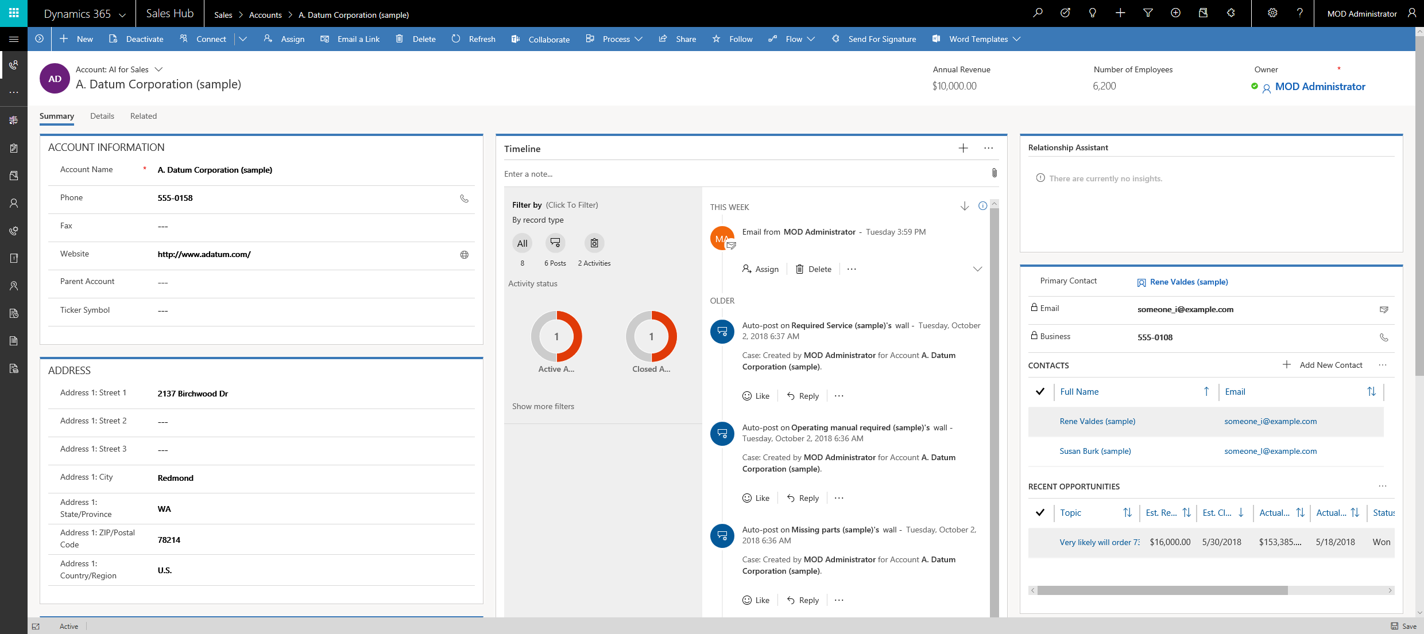
Manage customers as accounts
Notes:
As already covered earlier in this course accounts and contacts are both considered customers in Dynamics 365 for Sales. They are used to manage the primary data for a company or a person that works within the company. The data contained in these records may not change often and they provided the broadest context of the companies and people you are working with.
Account, Contacts and Leads can all be used with Marketing Lists.
When a lead is qualified, the name information will be used to create a new contact record. If the company fields have data on the lead, they will auto create as Account record. If a lead record has a relationship with an existing account or contact, new records are not created.
Account and contact records store much of the information that you and your team collect from your customers. In a business to business scenario you store data about companies you do business with in accounts and you store data about the people you know and work with in contacts. In a business to consumer scenario the primary record maybe a contact without an associated account record. In this situation the account maybe used to represent vendors, suppliers or families as an example.

Slide 6
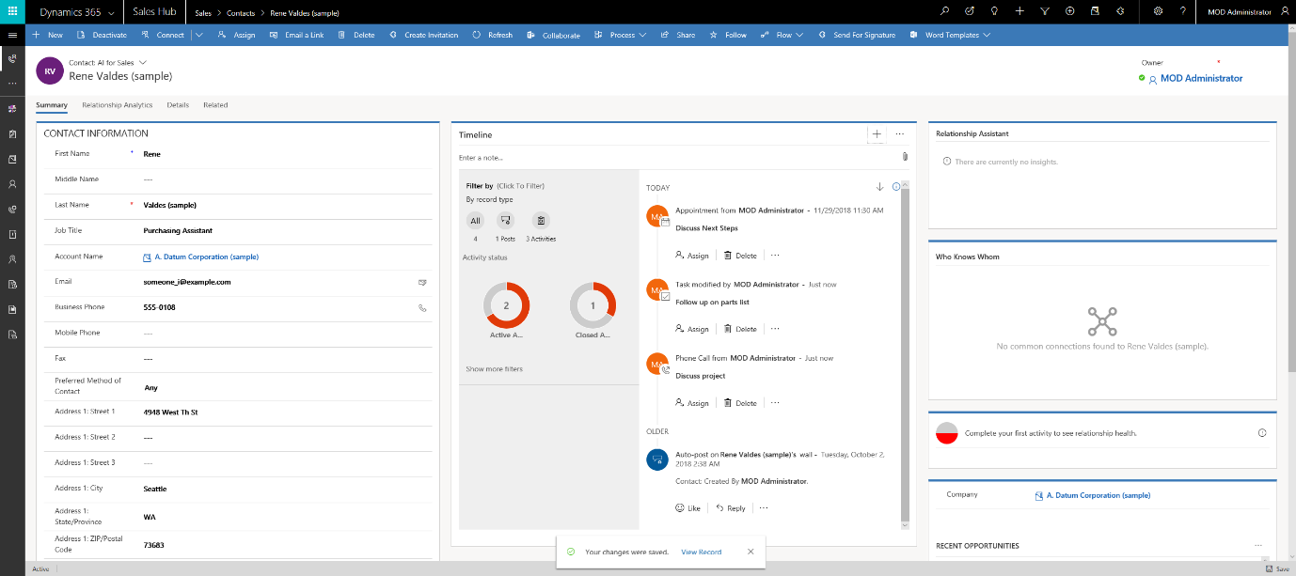
Manage customers as contacts

Slide 7
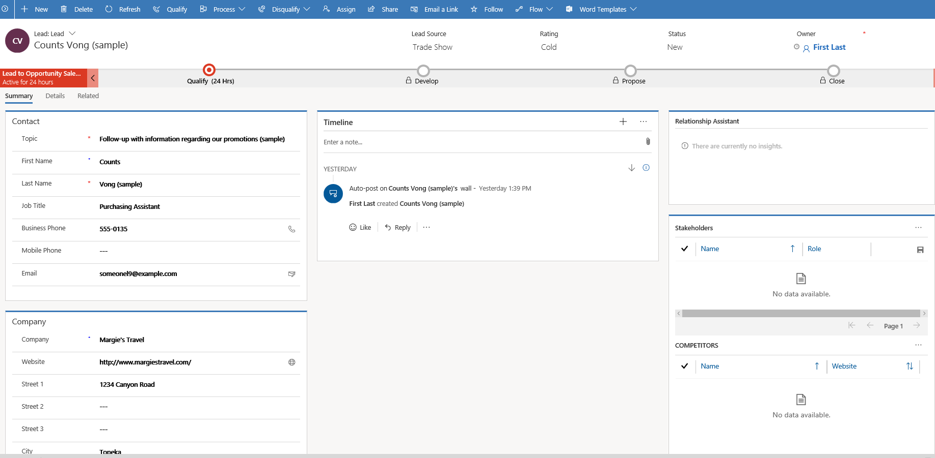
Work with leads in Dynamics 365 Sales
Notes:
In Dynamics 365 for Sales, you use leads to keep track of business prospects that you haven't yet qualified through your sales process. A lead can be an existing client or someone you've never done business with before, it is the entry to a new potential sale. You might get leads from different sources, such as advertising, networking, or email campaigns. Leads are great location to triage new customer data added to Dynamics 365.

Slide 8
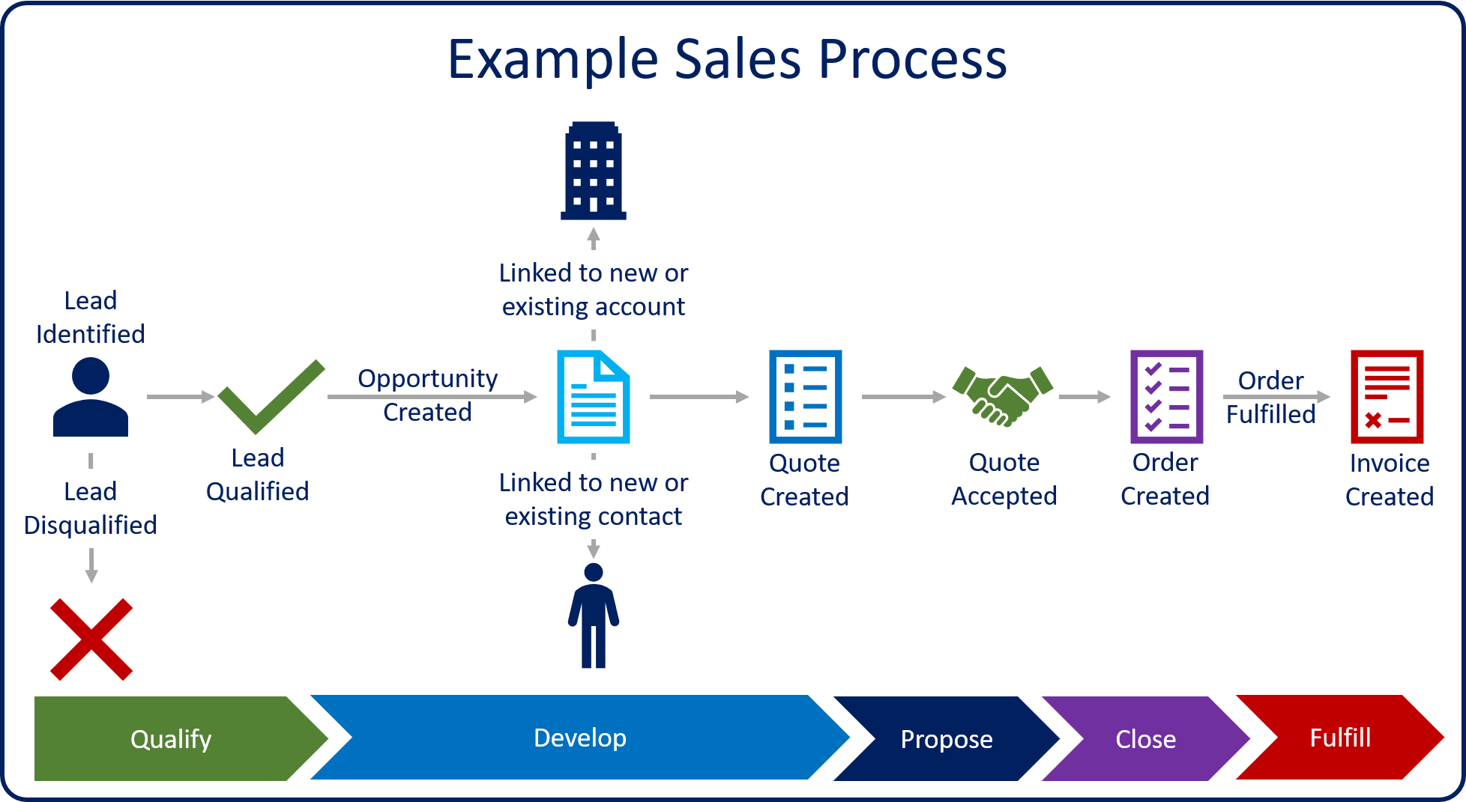
Work with leads in Dynamics 365 Sales

Slide 9
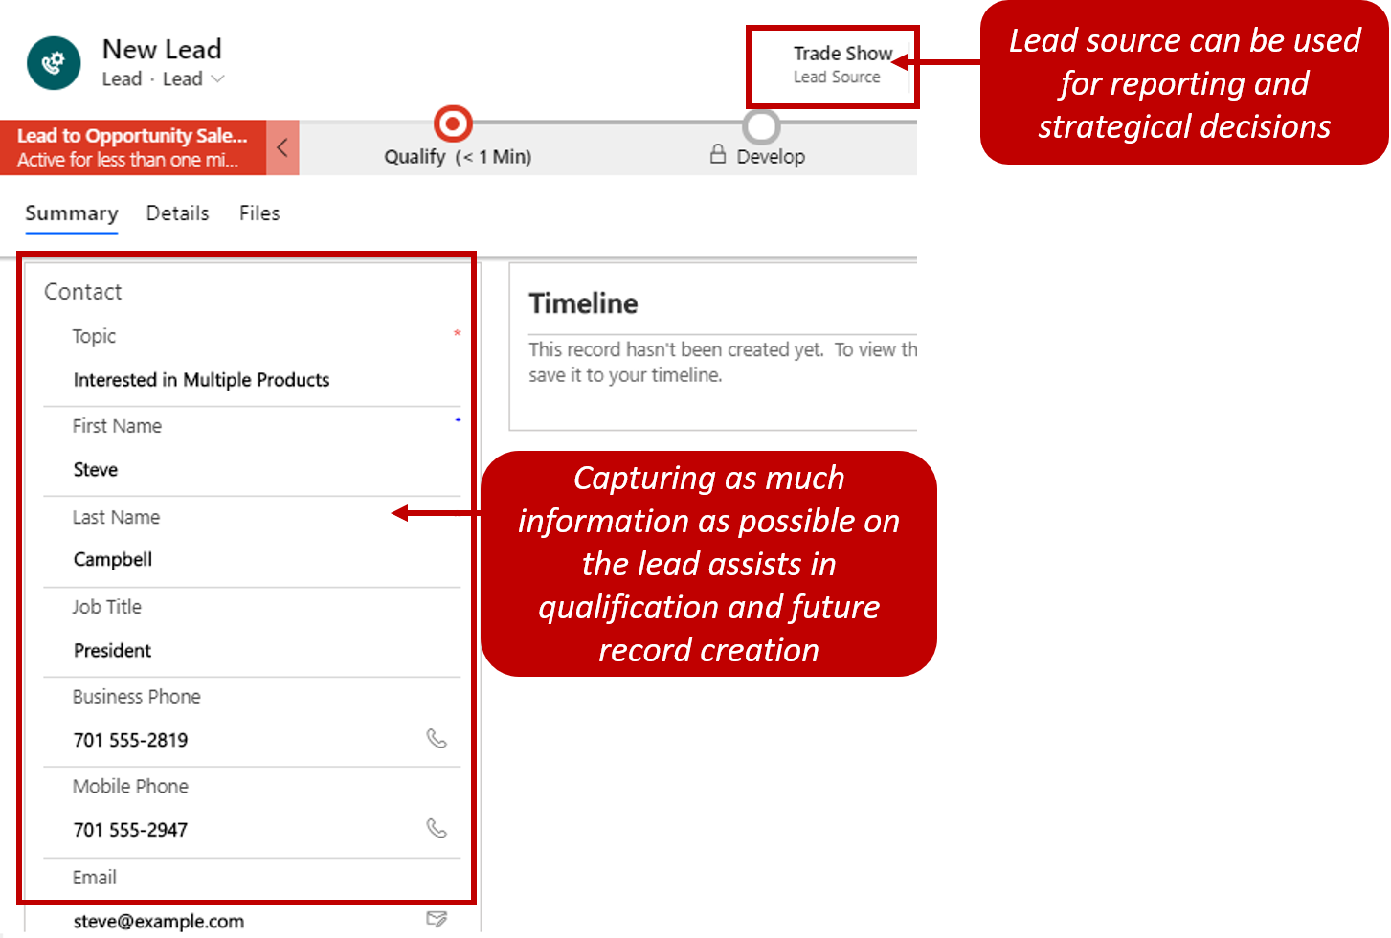
Create leads

Slide 10
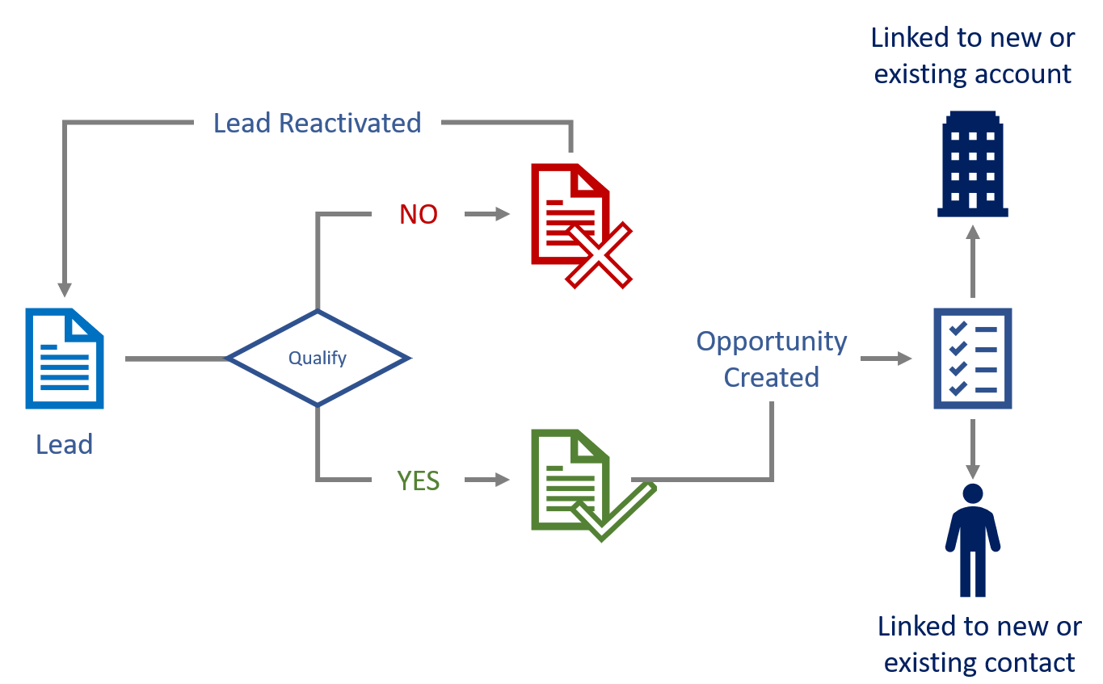
Lead management lifecycle

Slide 11
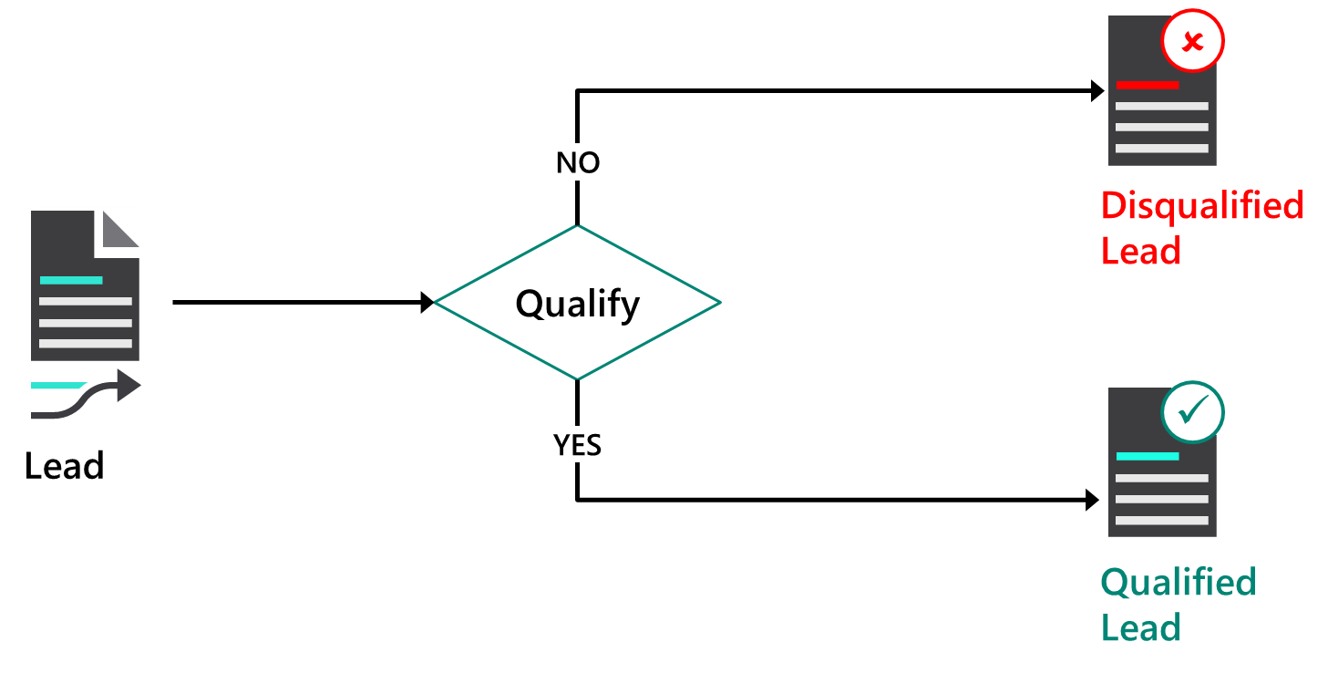
Qualify leads
Notes:
Does your lead have what you're looking for—and vice versa? After you've identified the timeframe, budget, purchase process, and decision makers for the sale, it's time to qualify your lead. Qualifying a lead in the Sales app converts it to an opportunity.
Ideally, your leads or prospects should have a need that you can provide a solution for and have the budget and influence necessary for making the purchasing decision. In addition, you should be able to provide their solution within the timeframe they need it.
Active Leads can either be Qualified, Disqualified or Deleted.

Slide 12
Lesson 3: Manage opportunities with Dynamics 365 Sales

Slide 13
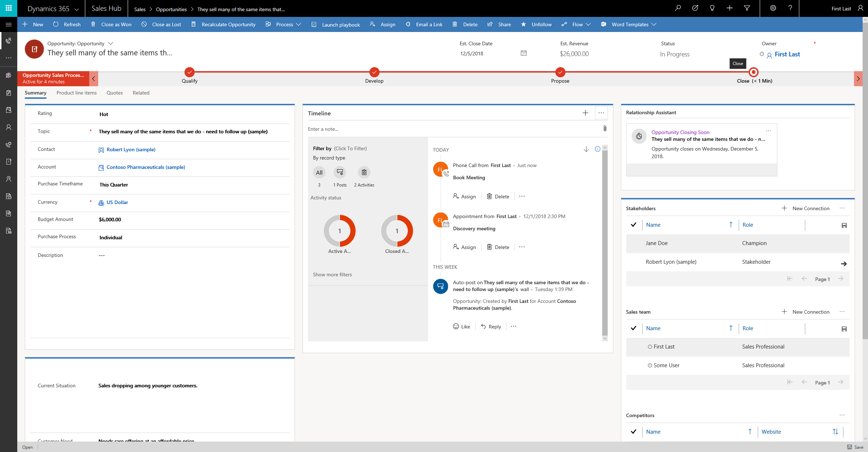
Work with opportunities in Dynamics 365 Sales
Should be attached to a customer
Revenue tracking
Data fills sales pipeline
Notes:
A video demo is available at the following link: https://youtu.be/lRlX90s3R6Y
You may show the video above, or you may use this demo as an example and provide students with a live demo in your personal environment. Please be aware that the video is publicly hosted on YouTube.
As already covered, Opportunities are used to manage potential sales. Opportunities typically have more potential than a lead.
Users can create opportunities manually or can be converted from a lead or activity. If your organization uses leads, you'll often convert leads directly into opportunities. In other situations, you might just create a new opportunity for an existing account or contact, or create an opportunity based upon an activity that has just occurred. As is the case system wide, there may also be a need where data records are imported into the system.
Opportunity records can have a status of open, won, or lost. Within Dynamics 365 for Sales, by default, opportunity records are saved with a status value of Open.
Open opportunities are conventionally used to represent potential sales and will often have sales processes associated with them. In addition, they can be modified as necessary.
When an opportunity is marked as Won, this indicates the customer has decided to move forward with the placement of an order or has signed a contract to provide services.
Now, the definition of what winning an opportunity means to an organization can be different from one organization to another. Because of this, it is important to define what it means to ‘win’ an opportunity, as it helps dictate how they will manage their overall opportunities.
If a record is LOST, the opportunity record can later be RE-OPENED if need be, if the customer changed their mind and wants to continue on with the sale.
Opportunity records can be DELETED by users with sufficient security privileges. However, it is important to realize that deleting an opportunity record also deletes any associated activities and notes. As a general rule, it is better to close opportunities as lost rather than delete them.

Slide 14
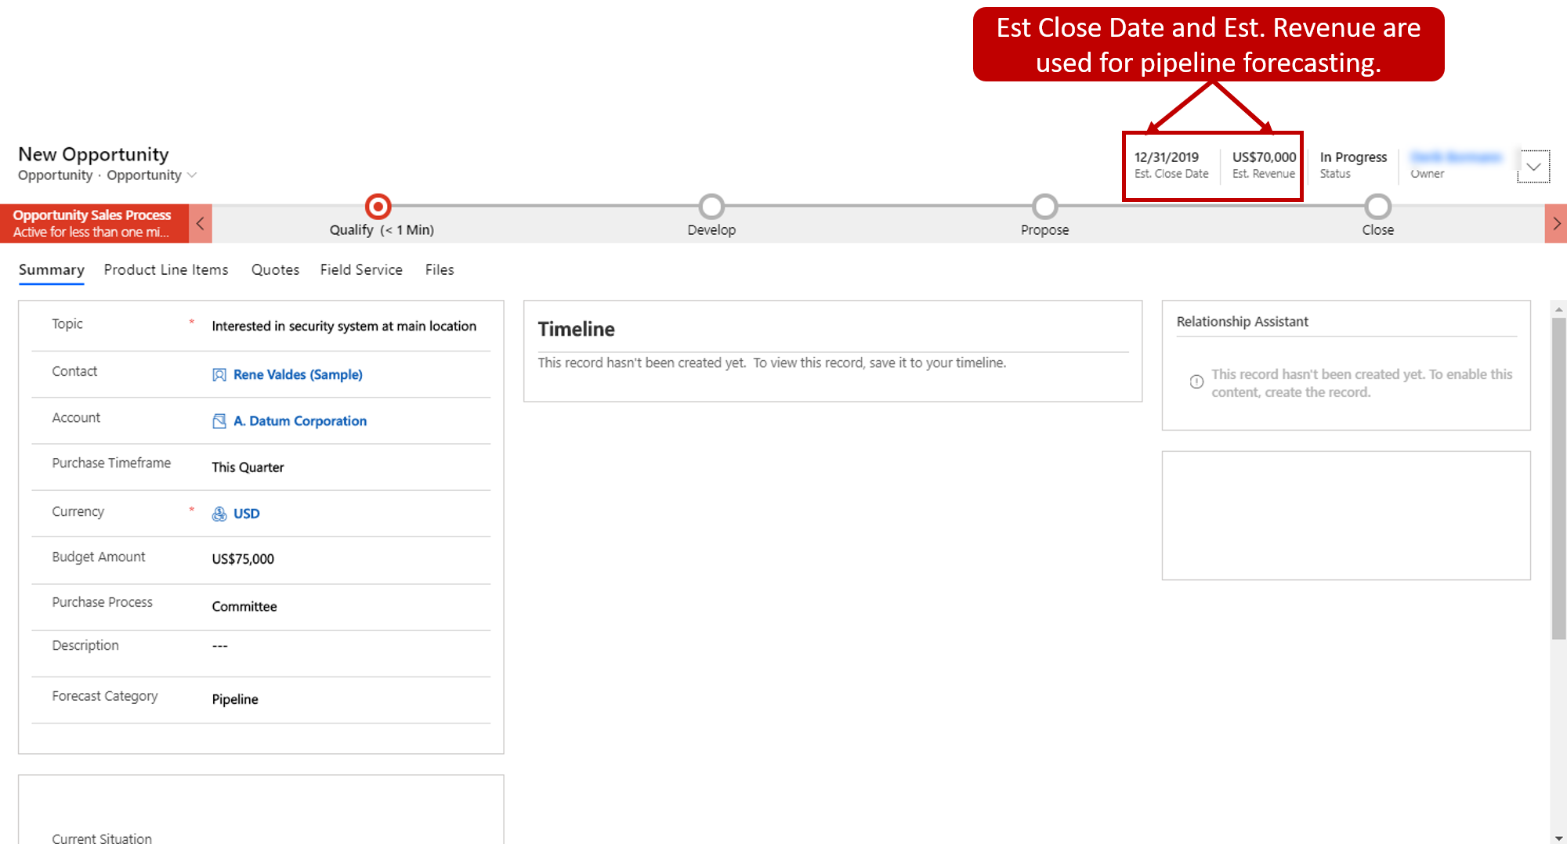
Create opportunities

Slide 15
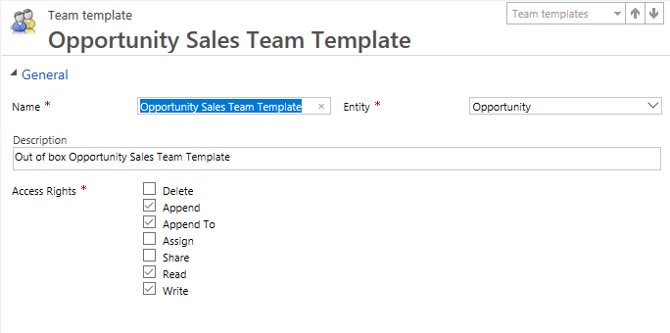
Account and team selling
Link sales tables to teams of users instead of a single user
Access teams:
Do not own rows
Provide flexibility to users for creating ad-hoc security on specific records as needed
Manual or via template
Notes:
Sales processes rarely occur in isolation. Every account, contact, lead, opportunity, and other records related to the sales have an owner, typically a user. However, the processes of qualifying a lead, closing an opportunity, winning a sale, and so on, are often results of a team’s work.
For every record in the app it’s helpful to be able to identify people within the organization linked or related to that record. Dynamics 365 for Sales includes some capabilities to relate records using connections. For example, the opportunity entity includes capability to connect the record to the users thus identifying the sales team.

Slide 16
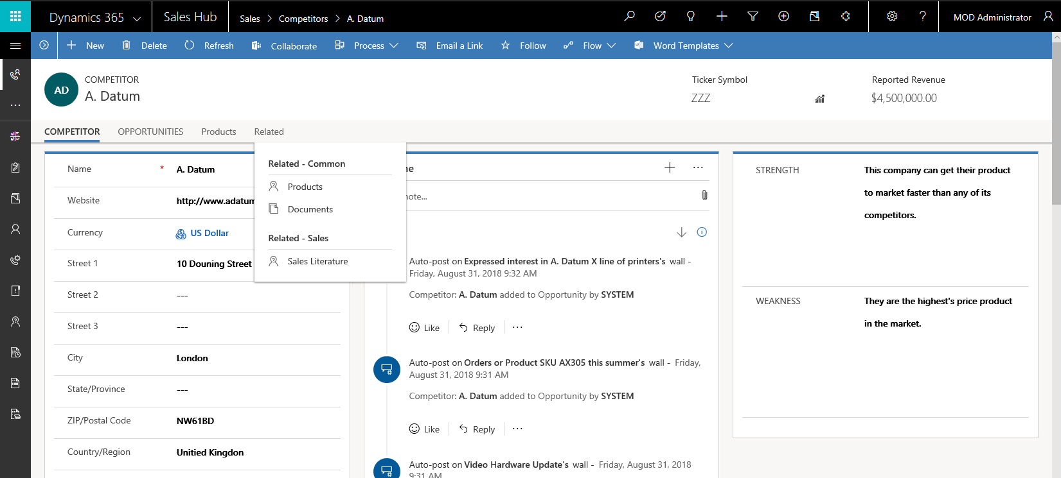
Competitors
Competitor: Who your organization is competing with (or lost the opportunity to)
Feeds default reports like Competitor
Win/Loss Report
Notes:
When tracking opportunities, knowledge about competition can be the difference between winning and losing. This knowledge can help the sales team better position their services and products against the competition, thus improving chances of winning.
Additionally, by using competitor records and either identifying that you are competing against them during the sales process or identifying which one you lost the opportunity to, default reports such as the Competitor Win/Loss report for Dynamics 365 for Sales provide a sales team a great deal of information into which competitors they do well against and which ones they may often lose to.

Slide 17
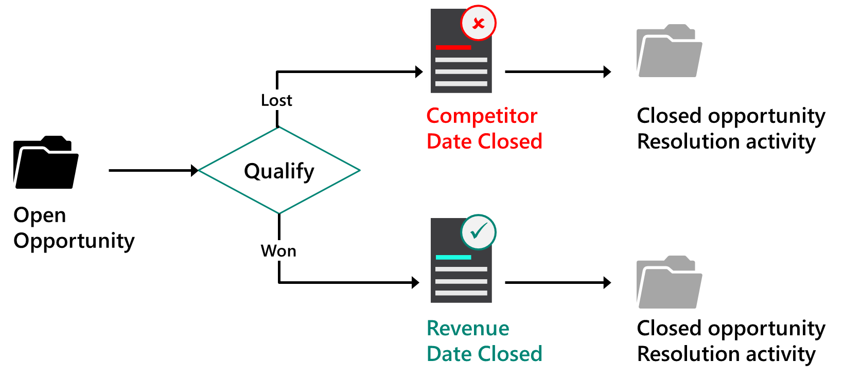
Opportunity management lifecycle
Notes:
Let’s look at the overall process for marking an opportunity as being won versus marking an opportunity as being lost in more detail. As we talk more about opportunities, it's important to understand the general flow…
We start with an open opportunity. Throughout the conversations we have with our customer, the goal of any opportunity is to at some point either be lost or, better yet, won.
If we mark the opportunity as being LOST, we have the option to identify which competitor lost the opportunity to, as well as the date that it was lost. Also, if we happen to know the overall value of the lost opportunity, we can indicate it as well.
When an opportunity is marked as lost, a special kind of activity record is created. It is called a Closed Opportunity Resolution Activity. This means every time you mark an activity as being lost, this resolution activity is auto generated. In the Resolution Activity, the information about the competitor you lost it to, the amount, and the date that it was lost are documented.
When we mark an opportunity as being WON, not only are we prompted with asking how much revenue did this mean to the business, but the date that it was won can also be indicated.
Like a lost opportunity, when an opportunity is marked as won, we have a Closed Opportunity Resolution Activity that is created. Again, in this resolution activity contains information about the total value of the opportunity as well as the date that it was closed.
With either status, Won or Lost, there will always be a Close Opportunity Resolution Activity created to show the interactions with the record.
One of the more common things that are done with sales opportunities is making sure that the right salesperson, or team of people, are working on the sales opportunity. That process is called assigning opportunities, or ‘Record Ownership’.
Assigning indicates who is ‘responsible’ for the management of the opportunity. This could be a primary salesperson, or it could be a sales team.
By default, when it is created, an opportunity has an owner associated with it. Sometimes though, the owner may need to be changed to another user. For example, if a sales representative has left the organization, their opportunities must be reassigned to another user, or team. For Opportunities, there are can be two possible owners of the record: an individual or a team.

Slide 18
Lab 2.1: Manage customers Demo 2.1: Customize the sales process

Slide 19
Closing slide

